Slide 1
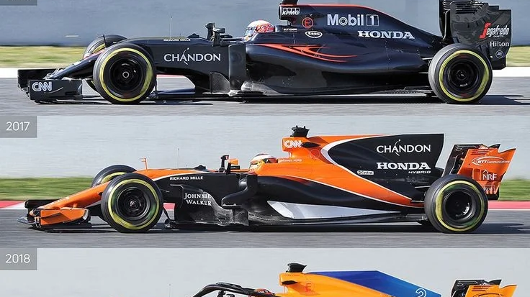
Development of McLarens F1 car and their advances in aerodynamics
ENG0018 Computer Laboratory 2025/26
Student URN: 6924828

Slide 2
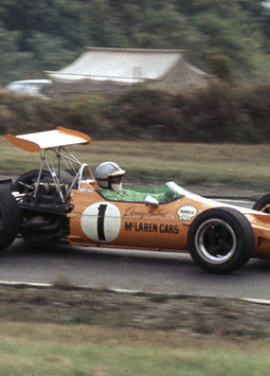
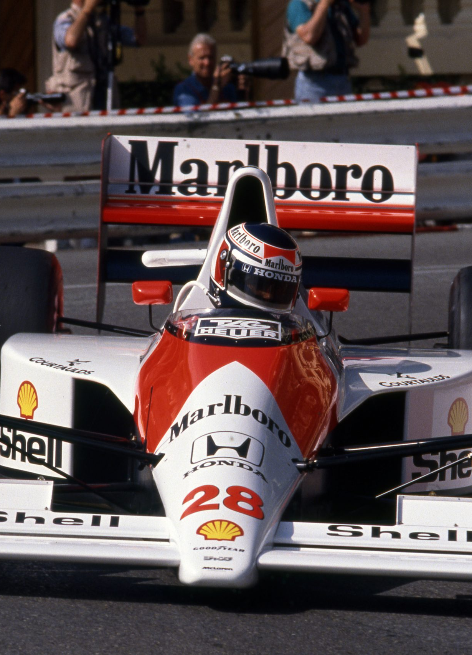
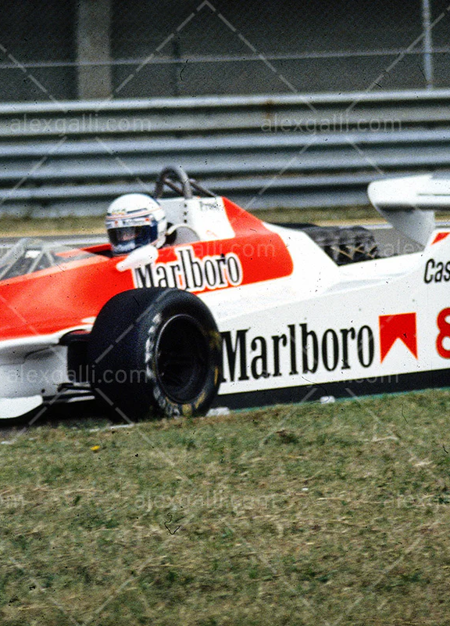
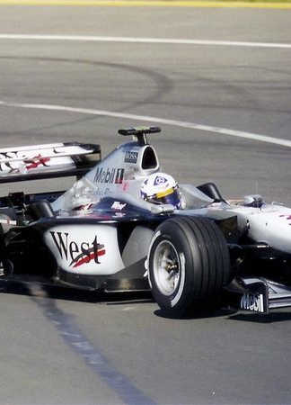
Time-line
1960s
1980s
1990s
2000s

Slide 3
Key aerodynamic advances
Ground effect principles
Evolution of front and rear wings
Diffusers and bargeboards
Computational fluid dynamics

Slide 4
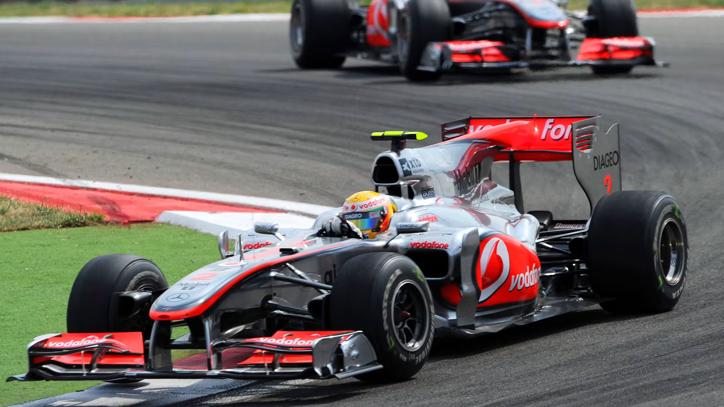
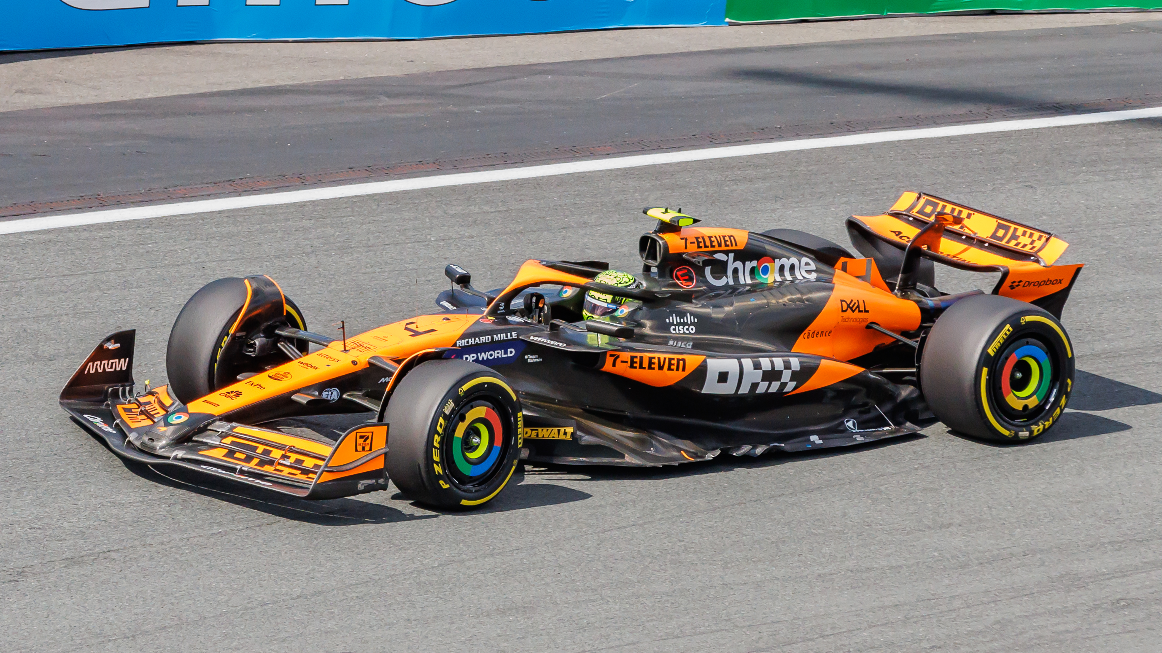
Most recent innovations
Compliance with current f1 regulations
Integration of hybrid power units
Sustainability and energy efficiency
Advanced aero optimization
2010s
Now

Slide 5

Conclusion
McLaren’s evolution from its experimental beginnings in the 1960s to its technologically sophisticated modern identity demonstrates a persistent commitment to innovation. McLaren’s development history mirrors the evolving technological landscape of Formula 1.
The team’s pioneering carbon-fibre work, aerodynamic breakthroughs, and engineering resilience have shaped not only their own success but the broader technical landscape of Formula 1. Although recent decades have brought challenges, the team’s renewed technical coherence and strategic reinvestment suggest a promising trajectory. McLaren’s legacy lies not just in past successes but in its sustained commitment to engineering creativity and resilience.

